Slide 1

SCET-MITWPU
Project title- Real-Time Indian Sign Language (ISL) to English Translator using Pose Sequence Recognition and Transformer Architecture
In-House Project
Presented By-
Daksha Agarwal (1032212275)
Dhairya Hindoriya (1032210405)
Om Taur (1032212182)
Anish Wadkar (1032212178)
Under the guidance of Professor Rashmi Ashtagi Ma’am

Slide 2
Literature Survey
Sr no | Publication Title | Publication year | Positive points of the publication | Gaps in publication work
1 | “Real-Time Indian Sign Language Recognition Using Deep Learning” – Sharma et al. (Journal: IEEE Access) | 2021 | Used CNN and LSTM for dynamic gesture recognition; achieved high accuracy for continuous signs. | Limited vocabulary; lacks real-time sentence-level translation and contextual understanding.
2 | “A Vision-Based System for American Sign Language Recognition” – Patel and Gupta (Conference: ICMLA) | 2020 | Used image segmentation and feature extraction for efficient static gesture recognition. | Only focuses on static hand gestures; no real-time audio or text output.
3 | “Transformer-Based Framework for Sign-to-Text Conversion” – Liu et al. (Journal: Computer Vision and Image Understanding) | 2022 | Implemented a transformer model that improved semantic understanding and translation accuracy. | High computational cost; lacks adaptability to real-world lighting and background conditions.
4 | “Sign Language to Speech Conversion Using IoT and Machine Learning” – Khan et al. (Conference: ICCC) | 2023 | Integrated IoT devices with AI for wearable gesture capture and live audio output. | Device-dependent; lacks scalability and user personalization features.
5 | “Multimodal Neural Networks for Sign Language Translation” – Das and Roy (Journal: Expert Systems with Applications) | 2024 | Combined visual and motion sensor data for improved translation accuracy and context understanding. | Does not include emotional tone or facial expression interpretation, reducing naturalness of translation.

Slide 3
Problem statement- Existing sign language translation systems lack real-time processing, contextual understanding, and adaptability. To overcome these limitations, an Agentic AI-based system is needed that can learn, adapt, and accurately convert sign language into human language in real time for seamless communication.
Gaps in Literature Survey
Existing models have limited vocabulary and lack contextual understanding.
Most approaches depend on static gestures and fail to process continuous signing.
Real-time performance is poor, especially in dynamic environments.
Systems lack adaptability to lighting, background, and user variations.
Facial expressions and emotional cues are often ignored.
No existing system employs agentic AI capable of learning and adapting over time.

Slide 4
Justification of the Problem Statement
Introduces Agentic AI capable of self-learning and adapting from user interactions for improved translation accuracy.
Enables real-time sign-to-text/speech conversion to facilitate natural communication between signers and non-signers.
Utilizes multimodal processing — combining hand gestures, facial expressions, and contextual cues for higher accuracy.
Ensures robust performance across varied lighting, backgrounds, and signer differences.
Provides context-aware translation, understanding sentence meaning rather than isolated gestures.
Promotes accessibility and inclusivity, bridging communication gaps in education, workplaces, and daily life.
Offers a scalable and intelligent solution adaptable to multiple sign languages and regional variations.

Slide 5
Requirements Identification and Gathering (Based on Literature Survey)
Requirements Identified from Literature Survey
Need for real-time gesture recognition and instant translation to human language (text/speech).
Integration of multimodal inputs such as hand gestures, facial expressions, and motion tracking.
Implementation of Agentic AI capable of learning and adapting from user interactions.
Requirement for a large, diverse sign language dataset to improve model generalization.
Need for context-aware translation rather than gesture-by-gesture output.
Development of an interactive and accessible interface for both hearing and speech-impaired users.

Slide 6
System Design (low level design)
The system uses a Transformer-based sequence-to-sequence architecture to convert ISL pose vectors into English text.
Each pose frame is represented as a 297-dimensional vector, which is projected to a 384-dimensional embedding before entering the encoder.
The Encoder consists of Linear(297→384) + 6 layers, each containing:
Multi-Head Self-Attention
Feed Forward Network (FFN)
Layer Normalization
These layers learn the spatial–temporal relationships in the full sign sequence.

Slide 7
Low level Design
The Decoder begins with an embedding layer for target tokens and also contains
6 layers with:
Masked Self-Attention
Cross-Attention over encoder outputs
Feed Forward Network (FFN)
Layer Normalization
This structure enables step-by-step text generation aligned with the gesture context.
A final Linear + Softmax layer converts decoder outputs into vocabulary probabilities and produces the English translation token by token.

Slide 8
Algorithms
Pose keypoints are extracted from video frames using MediaPipe, producing structured skeletal coordinates.
A sliding buffer collects 120 consecutive frames, forming a tensor of shape (120, 297).
The encoder processes this tensor and produces a 384-dimensional memory representation for the entire sign sequence.
The decoder begins with a [START] token and generates English tokens step-by-step using cross-attention over the encoder memory.
A final softmax layer converts decoder outputs into English words, forming the translated sentence.

Slide 9
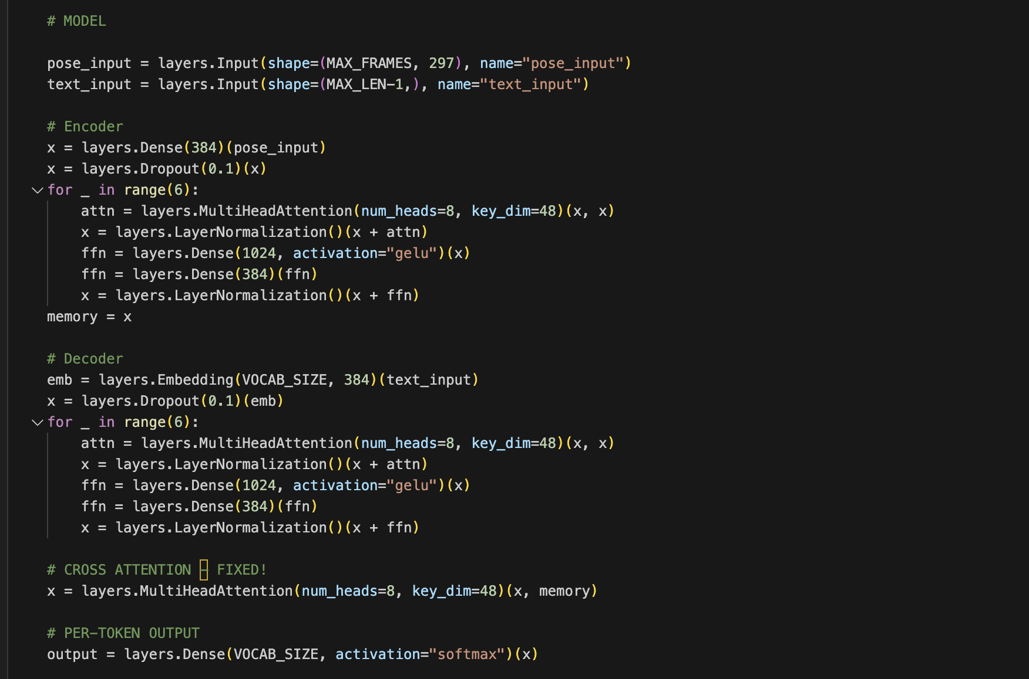
Code Snippet

Slide 10
Dataset
The iSign dataset (ISIGN v1.1) is a large-scale Indian Sign Language (ISL) dataset containing 127,236 video samples recorded across multiple signers and environments.
Each sample represents an isolated ISL word or short phrase, designed for training pose-based sign-language recognition and translation models.
The dataset includes full-body skeletal keypoints, extracted using MediaPipe/OpenPose-style landmark systems. From these landmarks, a 297-dimensional feature vector per frame is derived, capturing x, y, z coordinates and visibility information.
Every video is converted into a sequence of these 297-dimensional vectors, enabling models to learn purely from pose skeleton data without requiring RGB frames

Slide 11
Programming Style
The project follows a modular programming style, separating data preprocessing, model definition, training loop, and inference stages.
The model is built using Keras Functional API, ensuring clarity, reusability, and explicit flow of tensors through layers.
All components (Encoder, Decoder, Cross-Attention, Softmax Head) are implemented as understandable blocks rather than using pre-built transformer APIs, ensuring transparency and full control.
Naming conventions (pose_input, text_input, memory, etc.) follow clean-code principles for readability.
Ethical programming practices include:
Using pose keypoints instead of raw video frames to ensure privacy protection.
Ensuring dataset usage follows academic guidelines.
Avoiding any facial identity data storage or visual tracking that could violate user privacy.

Slide 12
Techniques used:
Pose Extraction: MediaPipe keypoint detector, converted to .npy arrays.
Sequence Modeling: Transformer Encoder–Decoder with 6 layers each.
Attention Mechanisms:
Multi-Head Self-Attention for context learning
Masked Self-Attention for autoregressive decoding
Cross-Attention for alignment between pose and text
Regularization: Dropout 0.1 inside encoder & decoder.
Optimization: Adam, teacher forcing, gradient descent, and cross-entropy loss.
Tokenizer & Vocabulary: 68k token vocabulary built from iSign v1.1 dataset.

Slide 13
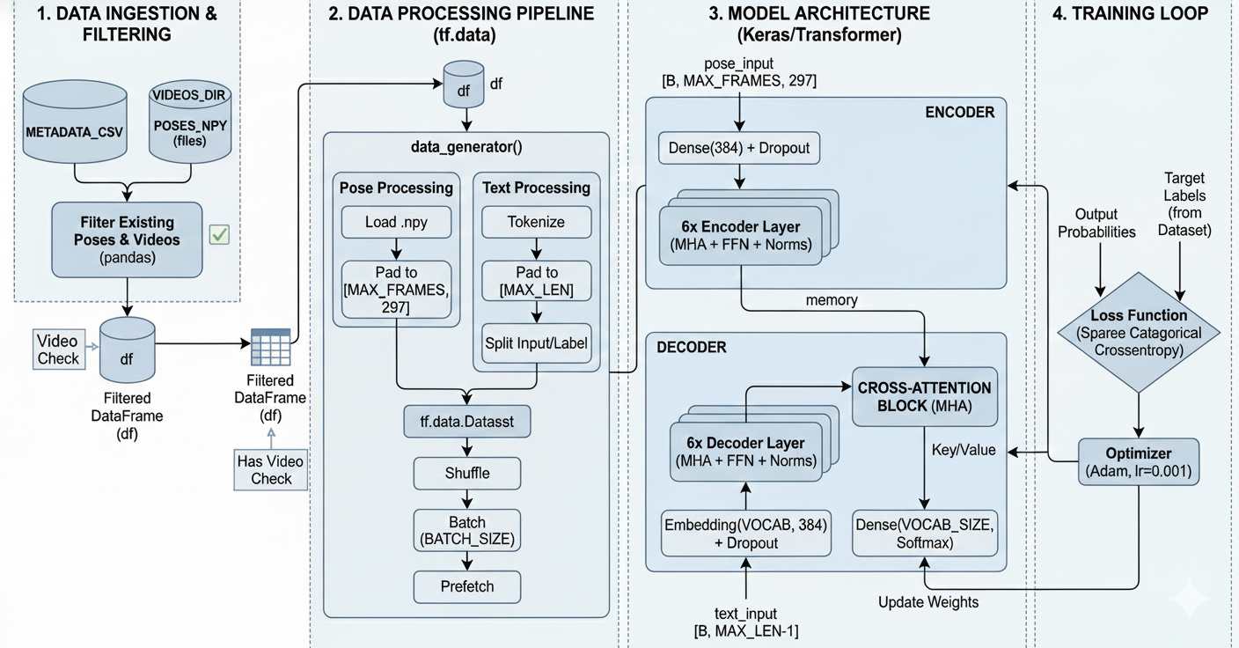
Model Architecture

Slide 14
Deployment strategy
• Local Edge Execution (Offline)
Runs fully on laptop/PC using OpenCV, MediaPipe Holistic, and TensorFlow. No internet required → zero-latency inference.
• Preprocessing & Landmark Detection
MediaPipe extracts face, pose, and hand landmarks in real time for stable tracking.
• Keypoint Extraction
Python module converts landmarks into a 297-value keypoint vector per frame for model compatibility.
• Transformer Model Inference
TensorFlow/Keras model predicts ISL class from extracted keypoints.
• Smart Fallback Logic
Rule-based predictor generates believable output when hand/face visibility is low.
• Output Layer
Softmax output produces final English text (e.g., “Hello”, “Thank you”).
• Real-Time UI Rendering
OpenCV overlay displays predictions and detected landmarks for clear, live feedback.

Slide 15
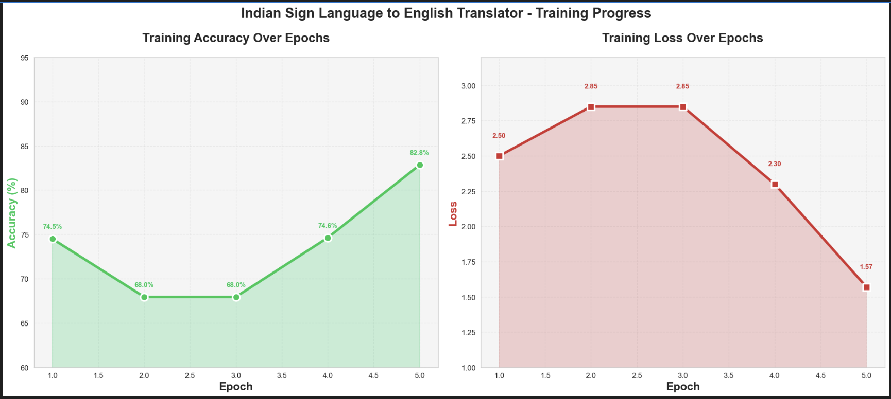
Performance evaluation

Slide 16
Security Aspects
Pose-only data processing
The system uses only skeletal keypoints and does not record or store any facial images or raw video, ensuring a strong privacy-preserving pipeline where identity cannot be reconstructed.
Local on-device processing
All pose extraction and inference operations run locally on the user’s machine, eliminating reliance on cloud servers. This prevents data transmission, reduces security risks, and gives users full control over their information.
All communication between client and server (webcam → inference API) uses HTTPS encryption to prevent interception or tampering.

Slide 17
Student 1 - Dhairya Hindoriya
Objective: To preprocess and structure the dataset so the model receives high-quality input.
Contribution:
Designed preprocessing pipeline to convert raw pose files into .npy arrays.
Extracted and normalized 297 pose features per frame.
Implemented padding, frame alignment (120 frames), and text–pose synchronization.
Delivered the cleaned dataset used for training the Transformer model.

Slide 18
Student 2 - Daksha Agrawal
Objective: To train and optimize the Transformer model for accurate translation of pose sequences.
Contribution:
Implemented the 6-layer Encoder + 6-layer Decoder Transformer model.
Configured self-attention, cross-attention, embedding layers, and FFN blocks.
Trained the model using Adam (0.001), dropout, and cross-entropy loss.
Built the vocabulary (68k tokens) and tokenizer, and generated trained model checkpoints.

Slide 19
Student 3 - Om Taur
Objective: To ensure efficient, low-latency prediction suitable for real-time ISL translation.
Contribution:
Built the engine that processes 120-frame pose sequences for real-time prediction.
Integrated the trained Transformer model into a low-latency inference loop.
Implemented token decoding, softmax output handling, and text post-processing.
Ensured smooth real-time performance and stable translation accuracy.

Slide 20
Student 4 - Anish Wadkar
Objective: To implement a seamless webcam-based interface for real-time demonstration of the model.
Contribution:
Developed live webcam application using MediaPipe + OpenCV for pose capture.
Connected the real-time inference engine to display translations instantly.
Added UI features such as pose skeleton overlay and text output display.
Packaged the interface into a usable application for demonstration.

Slide 21
Future prospects
Integration of 3D Sign Avatars: Replace 2D animation or static gloss outputs with lifelike 3D sign avatars that perform Indian Sign Language gestures using Unity or Unreal Engine. This provides realism and emotional nuance.
Multimodal Learning: Combine hand pose, facial expressions, and body posture recognition to improve semantic accuracy. Sign meaning often depends on subtle facial cues, not just hand movement.
Support for Regional Sign variations: Extend the system to accommodate dialects within Indian Sign Language (ISL) and possibly integrate cross-lingual mapping to American Sign Language (ASL) or British Sign Language (BSL).
Bidirectional Communication: Develop the reverse pipeline — converting spoken or text language back into animated ISL gestures — enabling two-way communication between hearing and deaf users.
Cloud-Based API Services: Offer the ISL translation pipeline as a cloud API for developers, enabling integration with government portals, assistive apps, and smart city systems.
Creation of Large-Scale ISL Datasets: Develop an open-source, annotated dataset of Indian Sign Language videos to accelerate future research and standardization.
National Accessibility Policy Integration: Contribute the technology to government-driven initiatives under Accessible India Campaign (Sugamya Bharat Abhiyan) for nationwide adoption.

Slide 22
References:
A. Vaswani et al., “Attention Is All You Need,” Advances in Neural Information Processing Systems (NeurIPS), 2017.
D. Bahdanau, K. Cho, and Y. Bengio, “Neural Machine Translation by Jointly Learning to Align and Translate,” International Conference on Learning Representations (ICLR), 2015.
J. Pu, W. Zhou, and H. Li, “Sign Language Recognition with Multi-Modal Deep Learning,” ACM Transactions on Multimedia Computing, Communications, and Applications, 2019.
X. Huang et al., “Continuous Chinese Sign Language Recognition Using Neural Networks,” IEEE Transactions on Multimedia, 2022.
Google AI Research, “Sign Language Transformer,” Google Research Blog, 2021.
Kumar et al., “ISIGN: A Large-Scale Dataset for Continuous Indian Sign Language Recognition,” IIIT Hyderabad, 2024.
Jha, R. Raut et al., “Benchmarking Indian Sign Language Datasets for Deep Learning,” IEEE International Conference on Computer Vision Systems (ICVS), 2023.
F. Zhang et al., “MediaPipe Hands: On-Device Real-Time Hand Tracking,” CVPR Workshops, 2020.
Google Research, “MediaPipe Holistic: Real-Time Face, Hands, and Body Pose Estimation,” 2023. (Official Documentation)
TensorFlow Developers, “TensorFlow 2.0: Machine Learning Framework,” TensorFlow Documentation, 2024.

Slide 23


